Slide 1
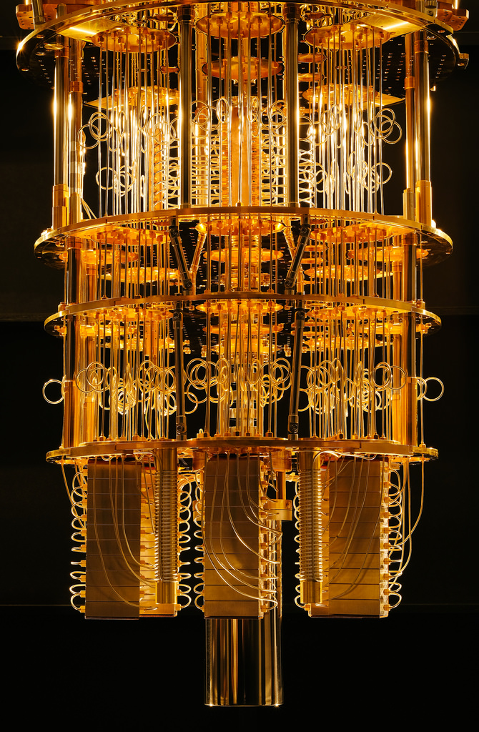
INTEGER FACTORIZATION USING SHOR'S ALGORITHM AND ITS IMPLEMENTATION ON A QUANTUM COMPUTER
Presenter
Aman Ganeju
Roll no:4080023
Supervisors
Om Krishna Suwal,PhD,
Dibakar Sigdel,PhD,
Shree Krishna Bhattarai,PhD.

Slide 2
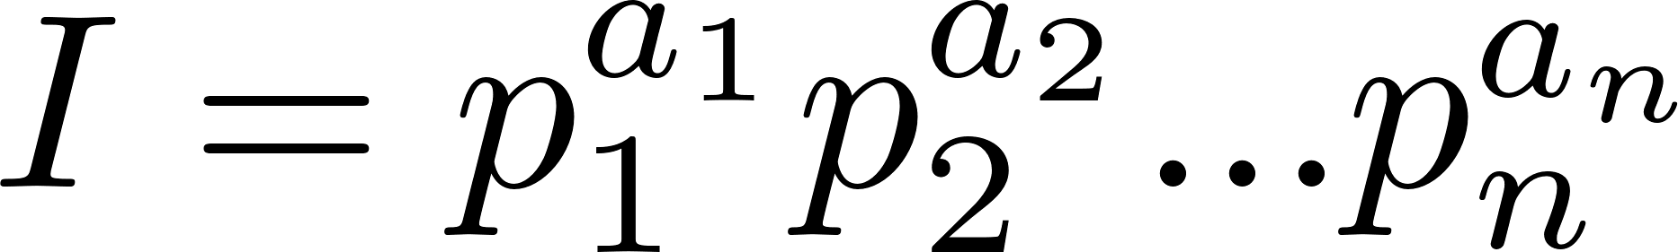
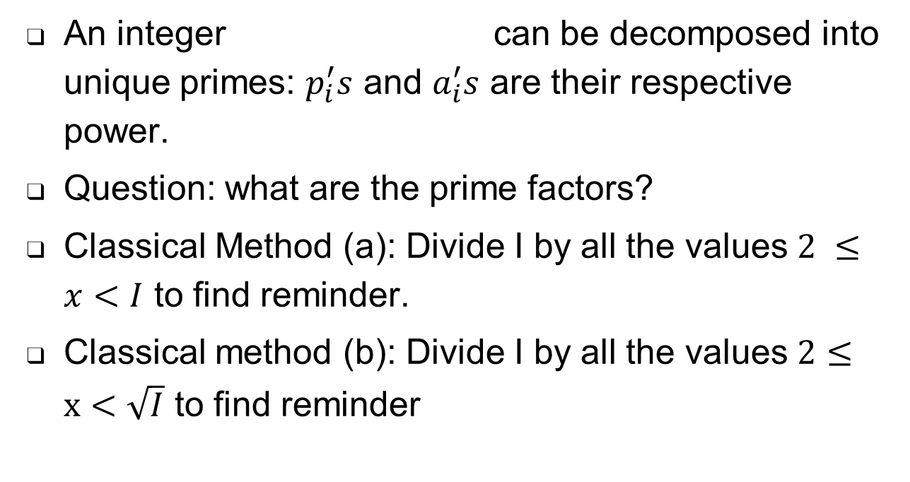
Integer Factorization
An integer can be decomposed into unique primes: $p_{i}^{′}s$ and $a_{i}^{′}s$ are their respective power.
Question: what are the prime factors?
Classical Method (a): Divide I by all the values $2 ≤x<I$ to find reminder.
Classical method (b): Divide I by all the values $2≤x<\sqrt{I}$ to find reminder
Notes:
An composite M is composed of a unique set of primes p_i’s.
However the question I’m into is what are the prime factors of it and how to find them.
A simple way is to divide the integer I by all the values from 2 to I. The values with reminder 0 is a factor.
By a little analysis, we can speed up the task by dividing I by all values from 2 to sq root of I because none of its factor is greater than square root of it.
we can see that the method (b) is better than method (a). But how do we define which is better or which is a difficult process.

Slide 3
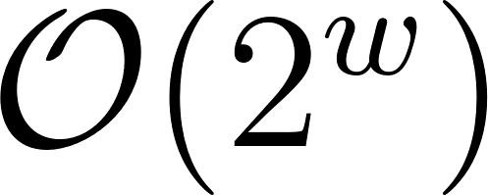
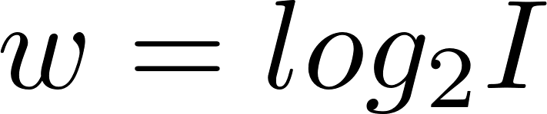
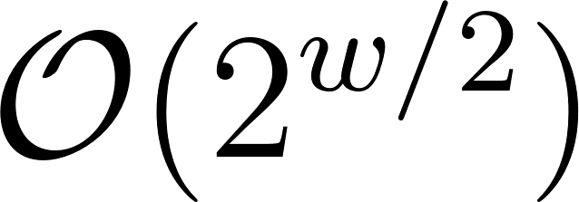
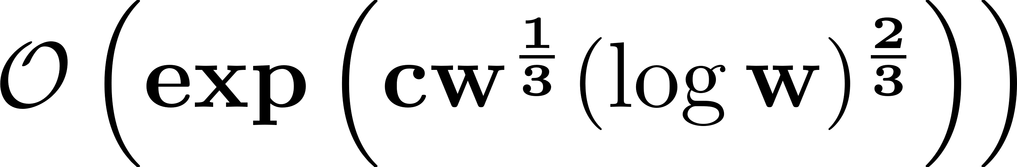
Complexity: amount of resources(time or space needed)
Method(a) takes time complexity where
Method(b) takes time complexity
The best known algorithm for factorization is General Number Field Sieve(GNFS):
time complexity: [2](Hamdi et al.,2014)
RSA cryptography is based on the difficulty of factoring problem
Notes:
In computational mathematics, we define difficulty of a problem based on the it’s complexity. Complexity of a problem is the amount of resources( time or space) required to solve a certain problem. It is usually computed for the worst case of a problem. The method (a) takes O(2^w) time complexity where w=log I. The big O notation represent amount of resources necessary at the worst case. So it means it takes exponential time or steps in performing factorization using this method.
Similarly method (b) takes O(2^w/2) time complexity which also represent exponential time.
The best known algorithm for factorization is General Number Field Sieve, which still has sub-exponential time complexity.
So even though factoring integer seems like an easy problem, the problem turns out to be really difficult as the size of integer gets larger. A popular cryptography system called RSA cryptography is based on the difficulty of the problem.
Now that is when shor’s algorithm comes in

Slide 4
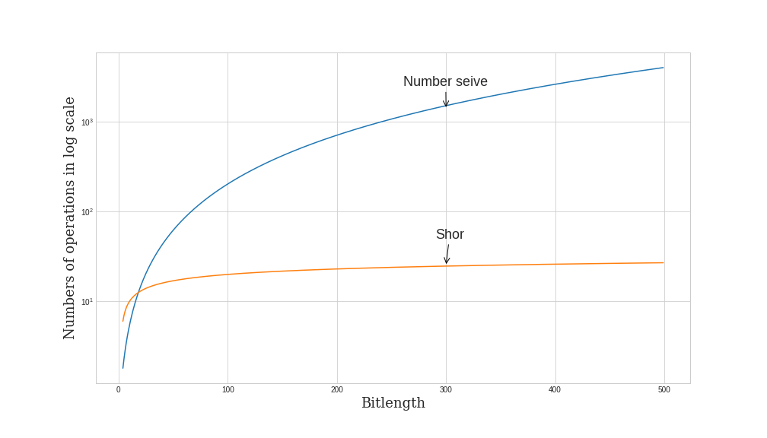
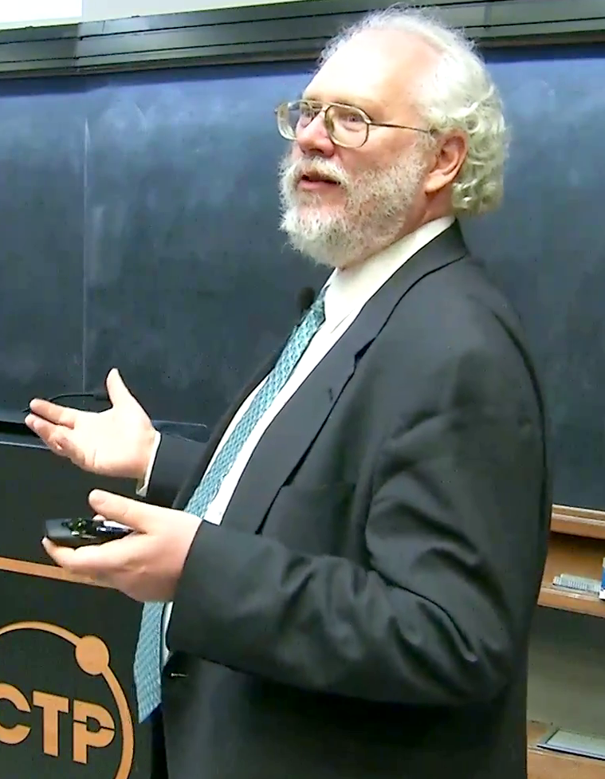
Shor’s Algorithm
It is a
Quantum Algorithm
Developed by Peter Shor in 1994
For composite integer factorization
In polynomial time with bounded error.
Peter Shor
Notes:
It is a Quantum algorithm i.e. a algorithm that runs on quantum computer. It was developed by Peter Shor in 1994
It factorizes integer in polynomial time but however with bounded error.
For comparison, this graph shows the difference in complexity of Shor’s algorithm and GNFS. Here the y axis is in logarithmic scale

Slide 5

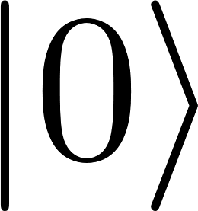

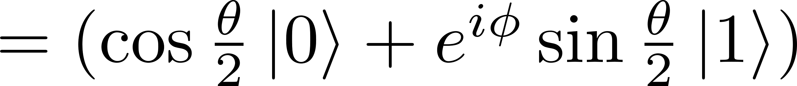
Introduction to Quantum Computing
Act of leveraging quantum mechanical properties to perform computing [3](Hidary, 2019)
Qubit
Basic unit of information
Superposition of and states
Notes:
I’ll be starting by giving a brief intro to quantum computing. Quantum computing is the act of leveraging quantum mechanical properties to perform computing
Qubits are the basic unit of quantum information. they are quantum analogue to classical bit. However unlike bits that have one of the two possible states 0 or 1, qubits can be in superposition of both the states
Superposition of a qubit can be expressed by the given equation where Alpha and beta are complex numbers satisfying normalization convention
This equation below is the geometric representation of a qubit. A qubit can be thought of as a vector in a unit sphere. The figure on right is called a Bloch sphere. Change in $θ$ changes amplitude and change in $φ$ changes phase of the qubit.

Slide 6
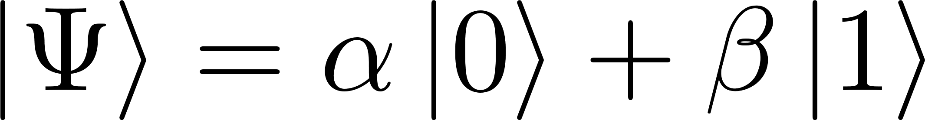
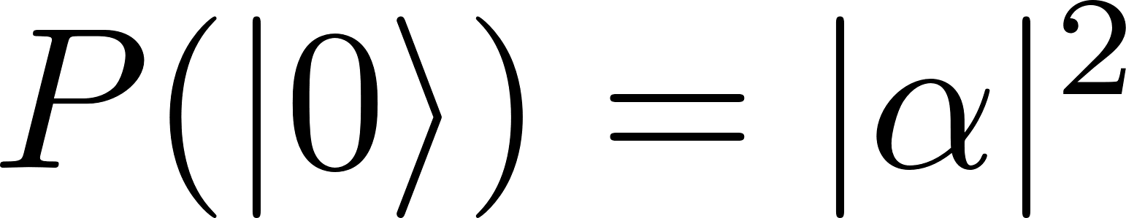
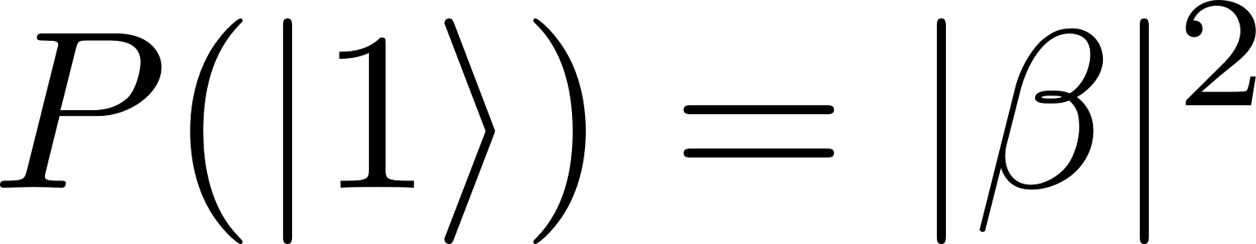
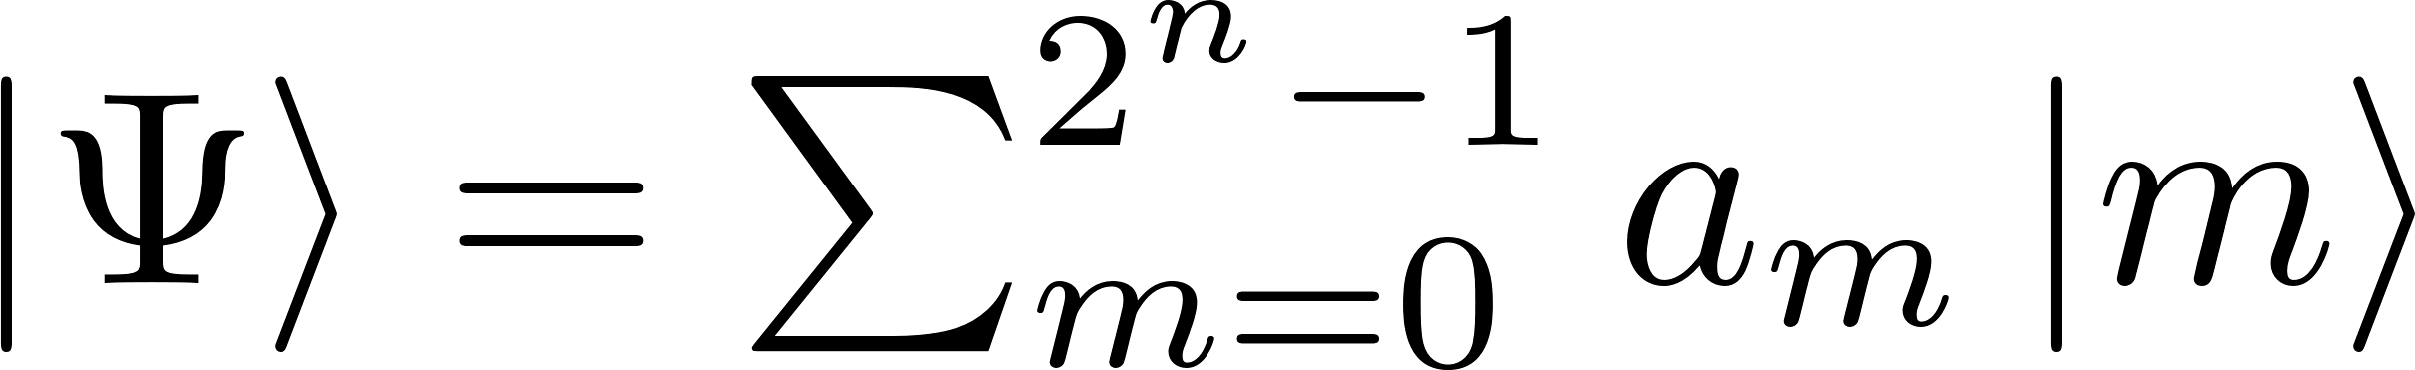
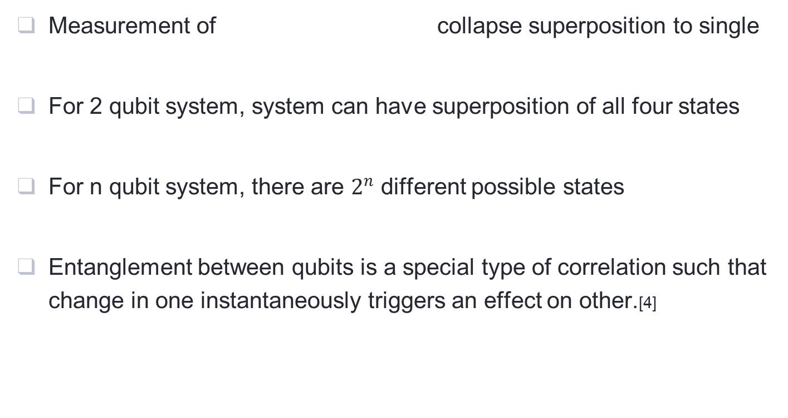
Measurement of collapse superposition to single
For 2 qubit system, system can have superposition of all four states
For n qubit system, there are $2^{n}$ different possible states
Entanglement between qubits is a special type of correlation such that change in one instantaneously triggers an effect on other.[4]
Notes:
For a single qubit in superposition, measurement collapses the qubit to give one of the two states with probability equal to square of its amplitude.
For 2 qubit system, system can have superposition of all four states 00 01 10 and 11 with certain probability
For n qubit system, there are $2^{n}$ different possible states whose superposition is given by the equation.
Another important QM property QC use is entanglement. Entanglement between qubits is a special type of correlation such that change in one instantaneously triggers an effect on other.

Slide 7
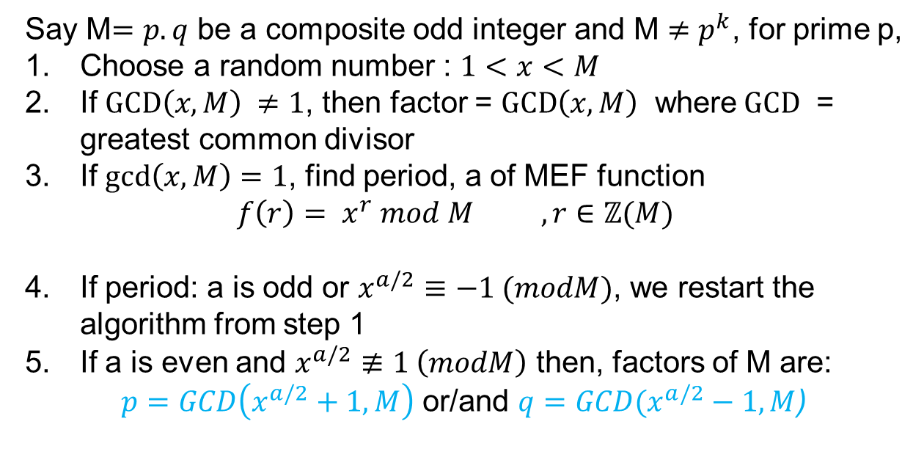
Theory of Shor’s Algorithm
Say M$=p.q$ be a composite odd integer and M $≠p^{k}$, for prime p,
Choose a random number : $1<x<M$
If $GCD\left(x, M\right) ≠1$, then factor = $GCD\left(x, M\right)$ where$GCD$ = greatest common divisor
If $gcd⁡\left(x, M\right)=1$, find period, a of MEF function
$$f\left(r\right)= x^{r} mod M , r∈ℤ(M)$$
If period: a is odd or $x^{a/2}≡−1 (modM)$, we restart the algorithm from step 1
If a is even and $x^{a/2}≢1 \left(modM\right)$ then, factors of M are:
$p=GCD\left(x^{a/2}+1, M\right)$ or/and $q=GCD⁡(x^{a/2}−1, M$)
Notes:
Now let’s talk about the algorithm itself. Say M be a composite odd integer and is not power of prime.
It starts by choosing a random number x >1 and < M. If Greatest common divisor GCD(x,M) $≠1$, it means there is a common prime factor between them, So the factor would be common prime: GCD(x,M).
If $gcd\left(x, M\right)=1$, i.e no common prime among x and M, we find period, a of a modular exponential function $f\left(r\right)= x^{r} mod M , r∈ℤ(M)$.
If a is odd or or $x^{a/2}=−1 (mod M)$, we restart the algorithm from step 1. The possibility of this occurrence is low for large number of trials. So there is a bounded error in the algorithm.
If a is even and $x^{a/2}=1 \left(modM\right)$ then, factors of M are: $p and q=gcd\left(x^{a/2}±1, M\right)$

Slide 8
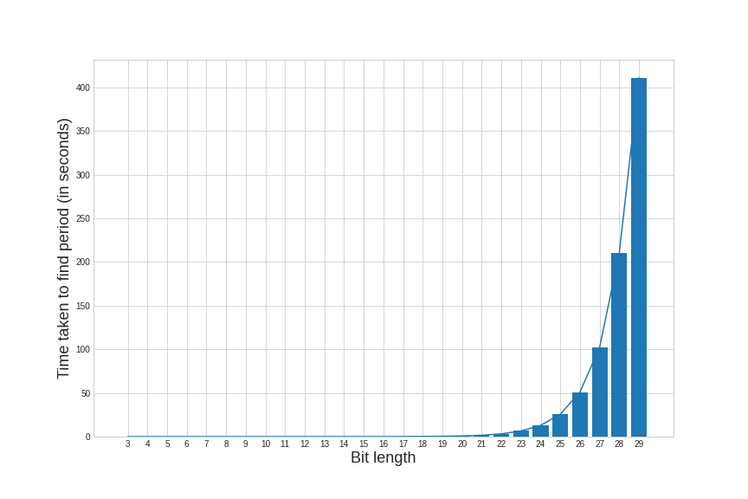
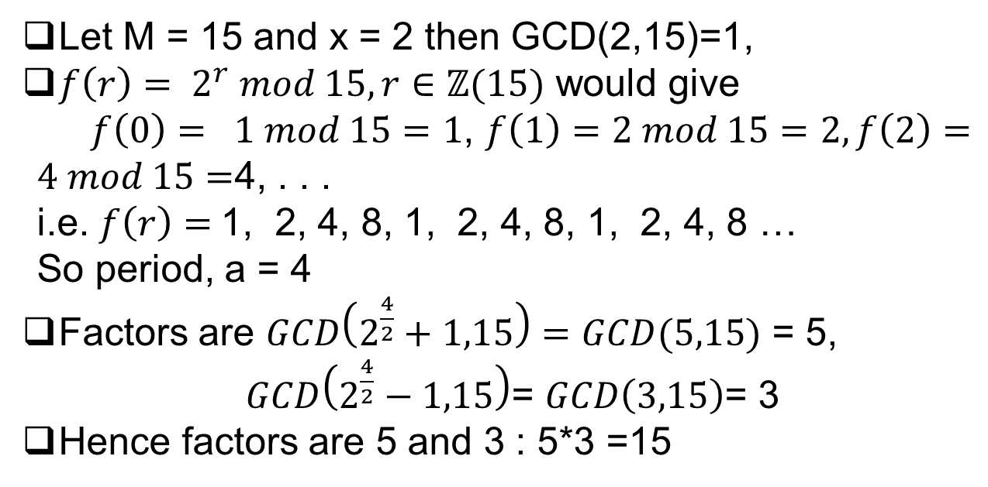
An example
Let M = 15 and x = 2 then GCD(2,15)=1,
$f\left(r\right)= 2^{r} mod 15, r∈ℤ(15)$ would give
$f\left(0\right)= 1 mod 15=1$, $f\left(1\right)=2 mod 15=2, f\left(2\right)=4 mod 15=$4, . . .
i.e. $f\left(r\right)=$1, 2, 4, 8, 1, 2, 4, 8, 1, 2, 4, 8 …
So period, a = 4
Factors are $GCD\left(2^{\frac{4}{2}}+1,15\right)=GCD(5,15)$ = 5,
$GCD\left(2^{\frac{4}{2}}−1,15\right)$= $GCD\left(3,15\right)$= 3
Hence factors are 5 and 3 : 5*3 =15
Fig: Amount of time required to find period of integer of increasing bit length
Notes:
It seems quite easy to compute the factors just looking at the example. It is so because the number to be factored is very small.
The hardest part of the algorithm is period finding problem. The complexity of the task increase exponentially as the number of bit representing the number M.
This graph show how the complexity grows as the bit length grows

Slide 9
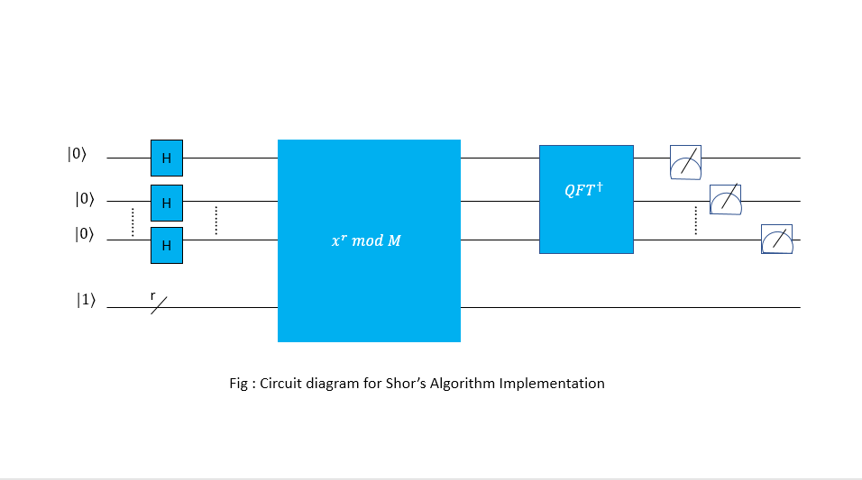
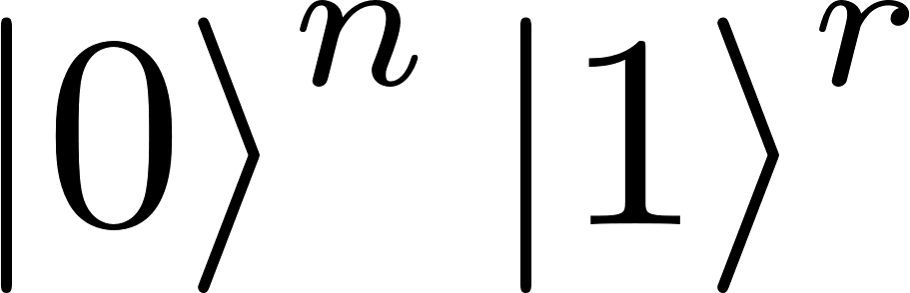

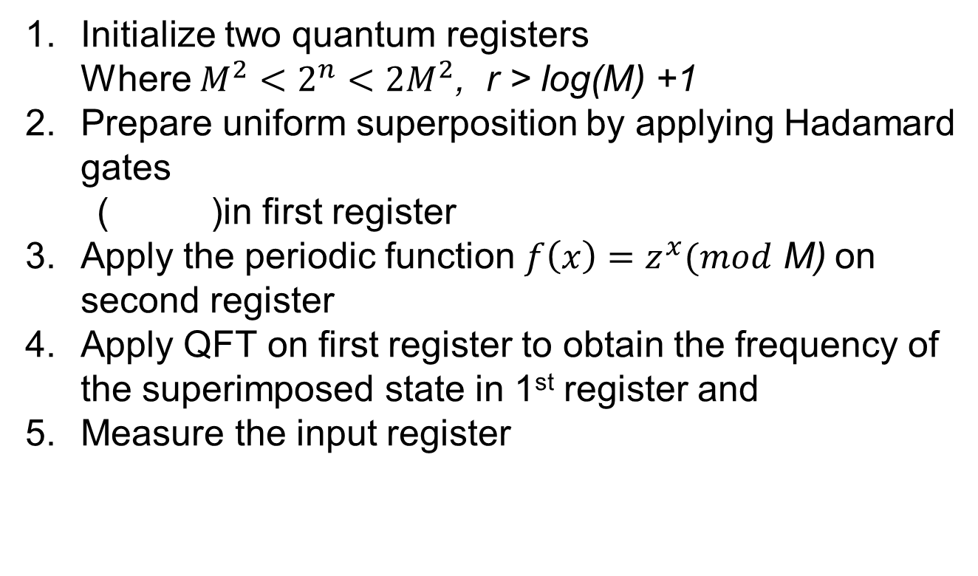
Shor’s algorithm on quantum computer
Initialize two quantum registers Where $M^{2}<2^{n}<2M^{2}\text{, }\text{r}\text{ > }\text{log}\text{(}\text{M}\text{) +1}$
Prepare uniform superposition by applying Hadamard gates
( )in first register
Apply the periodic function $f\left(x\right)=z^{x}(mod$ M) on second register
Apply QFT on first register to obtain the frequency of the superimposed state in 1st register and
Measure the input register
1st
reg
n
2st
reg
Notes:
It seems quite easy to compute the factors just looking at the example. It is so because the number to be factored is very small.
The hardest part of the algorithm is period finding problem. The complexity of the task increase exponentially as the number of bit representing the number M.
This graph show how the complexity grows as the bit length grows

Slide 10
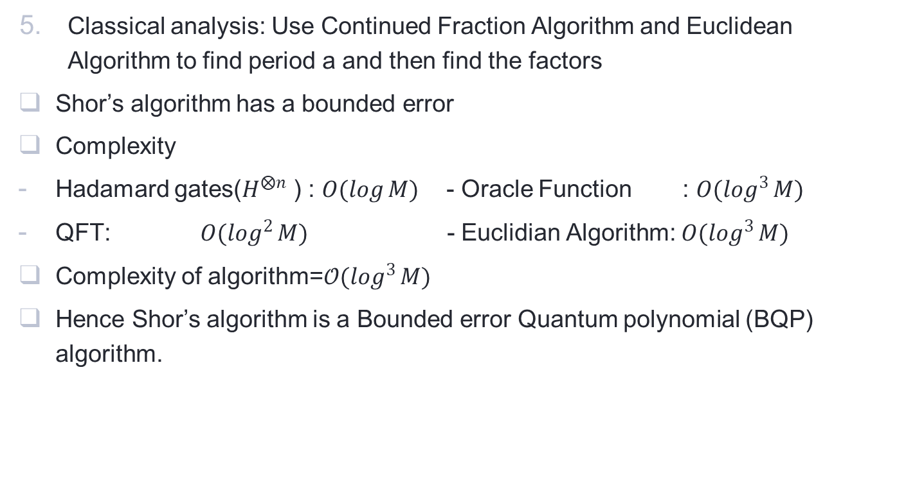
Classical analysis: Use Continued Fraction Algorithm and Euclidean Algorithm to find period a and then find the factors
Shor’s algorithm has a bounded error
Complexity
Hadamard gates($H^{⨂n}$ ) : $O(\log{M)}$- Oracle Function : $O(\log^{3}{M)}$
QFT: $O(\log^{2}{M)}$ - Euclidian Algorithm: $O(\log^{3}{M)}$
Complexity of algorithm=${𝒪(log}^{3}{M)}$
Hence Shor’s algorithm is a Bounded error Quantum polynomial (BQP) algorithm.
Notes:
The output of QFT is analyzed using classical algorithms namely Continued Fraction Algorithm and Euclidian Algorithm to find period a and using that to find factors.
Shor’s algorithm has a bounded error. Due to the probabilistic quantum nature of QFT, random collapsing on measurement, unacceptable other period, there is a certain probability that shor’s algorithm will fail in a single trial. But we can increase the number of trials to ensure correct answer with bounded error.
Complexity is the measure or resources used for an algorithm. The Hadamard gate has complexity of o(log M) ,QFT has O(log^2 M) oracle function has o(log^3 M) and Euclidian algorithm has O(log ^3 M).These are all polynomial complexity
Thus, Complexity of algorithm= $O(\log^{4}{M)}$
This proves Shor’s algorithm is a Bounded error Quantum polynomial (BQP) algorithm.

Slide 11
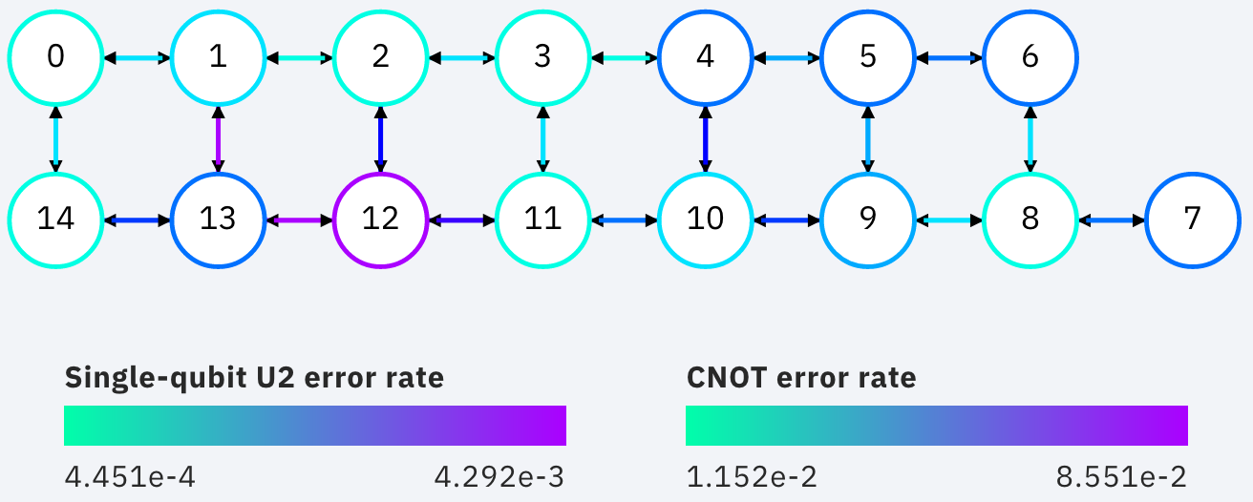
Methodology: Implementation
Programming language: Python; package :Qiskit
Qiskit: an open source SDK to work with quantum circuits and algorithms, and acts as interface for running quantum circuits on quantum computers at IBM [8]
Hardware: ibmq_qasm_simulator and ibmq _16_Melbourne
ibmq_qasm_simulator : quantum simulator at IBM
ibmq _16_Melbourne : a 15 qubit quantum computer at IBM
Qubits used: 0,1,2,3,13,14
Topography diagram and coupling map of ibmq _16_Melbourne [8]
Notes:
For the implementation of shor’s algorithm to factor integer, we used python programming language and specifically a package qiskit
Qiskit is an open source SDK to work with quantum circuits and algorithms, and it also acts as interface for running quantum circuits on quantum computers at IBM
For hardware, we used ibmq_qasm_simulator and ibmq _16_Melbourne
ibmq_qasm_simulator is quantum simulator at IBM. It is a classical computer that simulates QC using mathematical formulations of quantum computing.
ibmq _16_Melbourne is a 15 qubit quantum computer located at ibm quantum. It used superconducting qubits made up of Josephson junction diode.

Slide 12
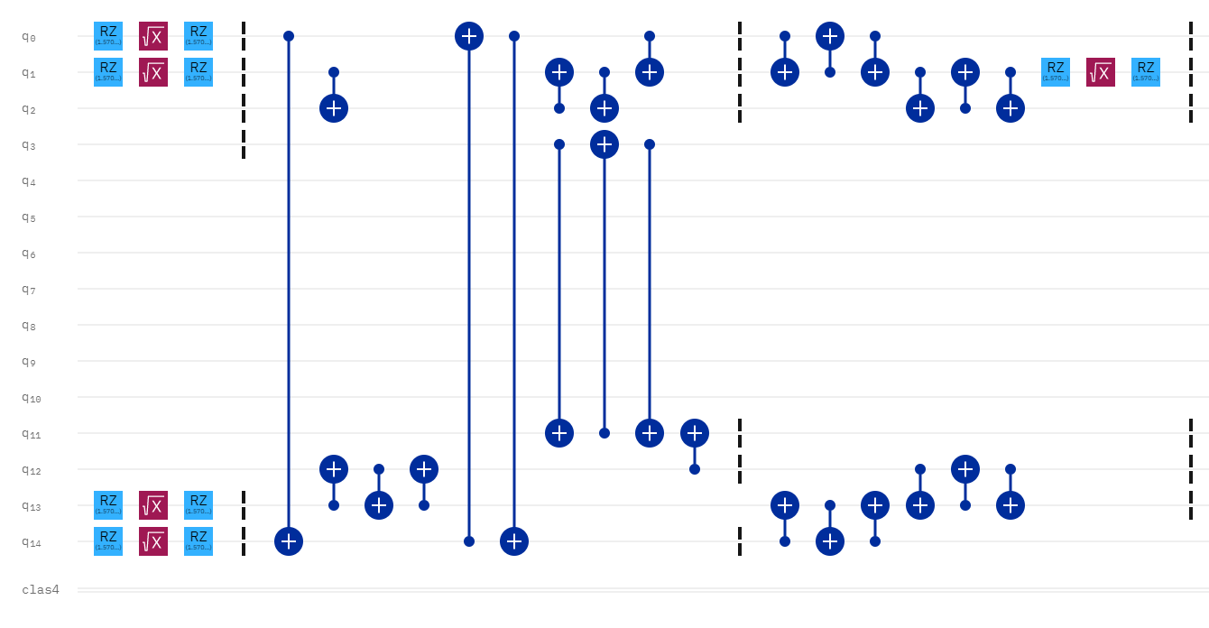
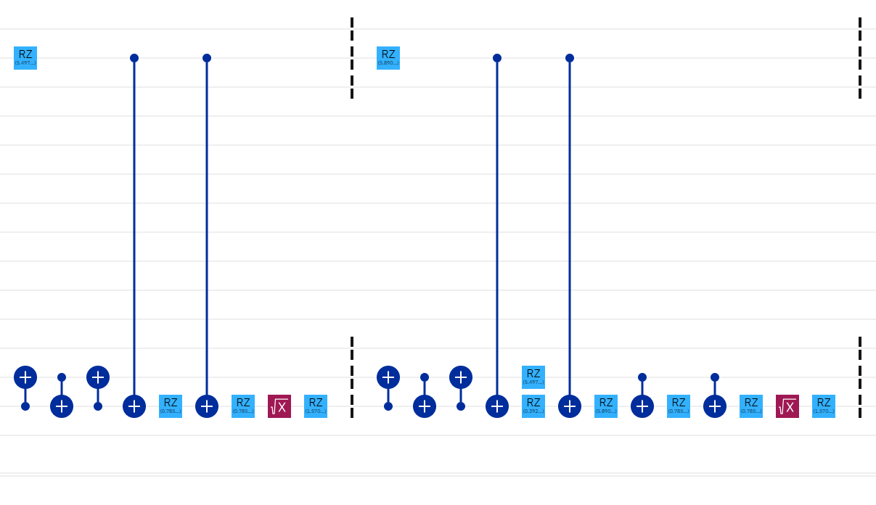
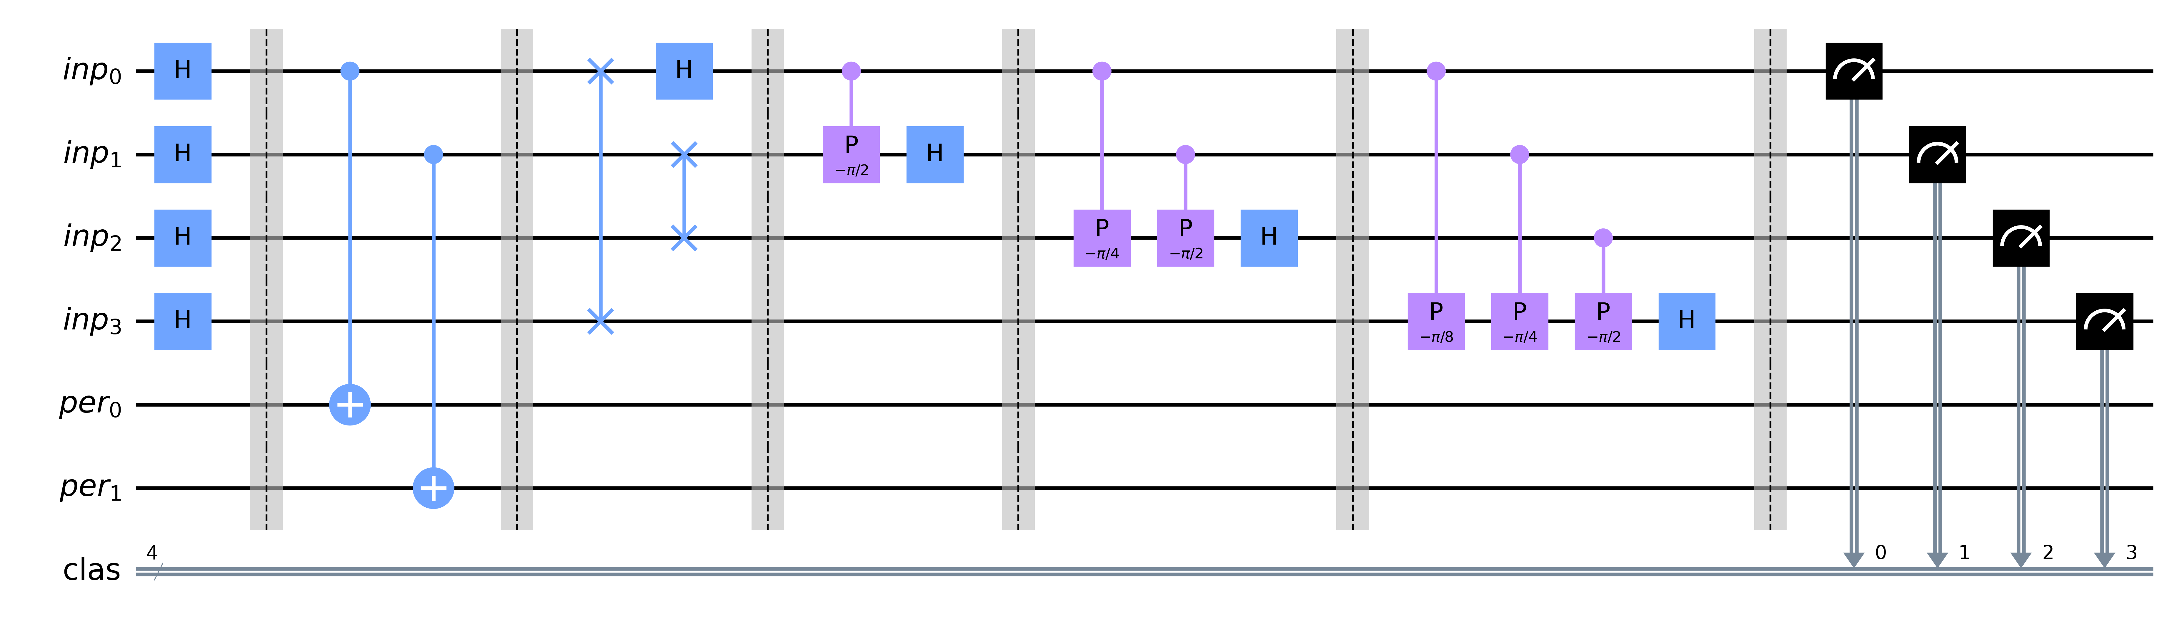
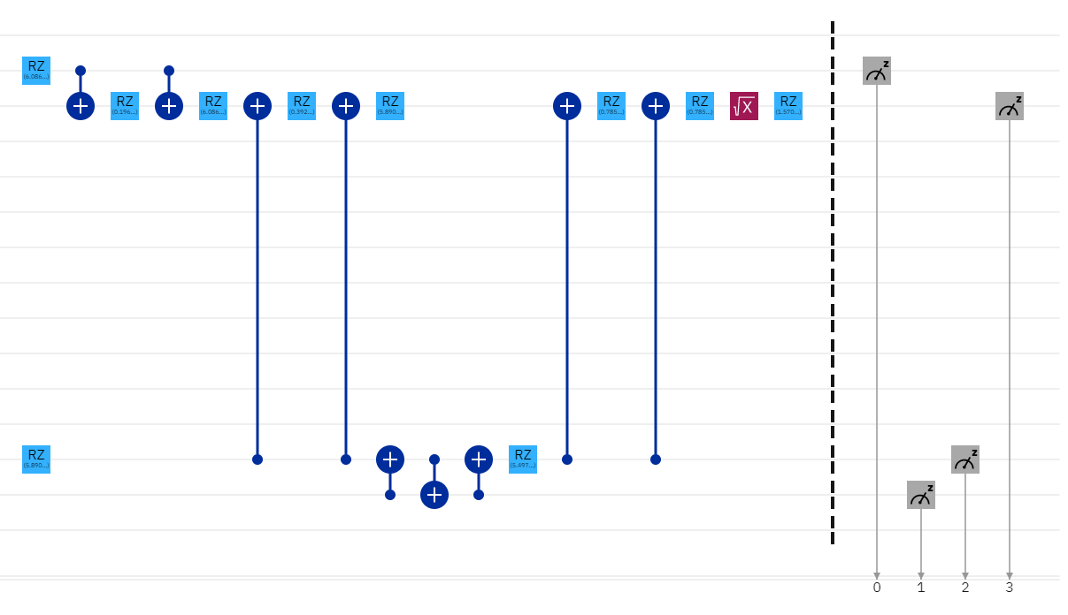
Circuit design
Factor an integer I=15 with base z = 2 for MEF
Created a simplified compiled version of Shor’s algorithm (Geller and Zhau,2013)
Fig: Quantum Circuit diagram for Shor’s Algorithm to factor integer 15
Notes:
Now for circuit design, we choose to factor an integer I=15 with base z=15 as the available number of qubits and the allowed depth is small for quantum computer at present.
It requires 4 qubits input register and 2 qubit period register
We created a simplified and compiled circuit for shor’s algorithm. It was inspired by a paper by Geller and Ghau.
This circuit is the initial circuit prepared on qiskit. But to run the circuit on ibmq _16_Melbourne , it need to be transpiled to circuit of 15 qubits. The transpiled circuit diagram is

Slide 13
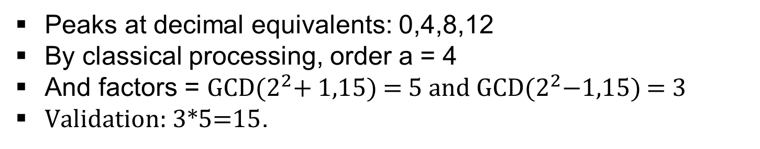
Result
On ibmq _16_Melbourne QC
On ibmq_qasm_simulator
Peaks at decimal equivalents: 0,4,8,12
By classical processing, order a = 4
And factors = GCD($2^{2}$+ 1,15) = 5 and GCD($2^{2}$−1,15) = 3
Validation: 3*5=15.
Notes:
Upon running the circuit on simulator, the result if represented by the histogram above.
Result by QC is represented by the histogram on the right. We can see that the values with maximum probabilities in result by QC corresponds to the same values by simulator.
Here the peaks are at values with decimal equivalents: 0, 4, 8, 12.
Then by classical processing, we get the order to be 4.
The factors are then computed to be 5 and 3
Finally we check the validity of the result by taking the product of the factors so obtained

Slide 14
Discussion
Dissimilarities in results
Quantum Errors
Scalability
On ibmq _16_Melbourne QC
On ibmq_qasm_simulator
Notes:
Between the results between result of simulator and QC, we can see some dissimilarities between the results of the output histogram.
We can see that there are some values with small probabilities on the output by QC, that is not present in result by simulators. The reason of these discrepancies is errors collectively known as quantum errors
Quantum errors are some errors present in QC due to imperfection in hardware. It is caused due to decoherence of qubits, errors in entanglements, measurement errors, gate errors and other errors. These are some of the reason, shor’s algorithm is not scalable at present
Scalability of shor’s algorithm is hindered by quantum error and lack of qubits. Qubits are hard to control and store, making it hard to prepare a large qubit system. At present the largest quantum computer has qubits only which is really small compared to classical computers.

Slide 15
Significance: Break RSA cryptography
A widely used cryptographic system for online data transmission including emails and online payments
Based upon the difficulty of factoring a large number
300 trillion years for classical computer to break 2048 bit key while it takes 10 secs for 4099 qubit QC(Zhang, 2020)
Largest experimentally factored number by quantum computer using Shor’s algorithm: ‘21’ (Martin-Lopez,2012)
RSA-(2048) = 2519590847565789349402718324004839857142928212620403202777713783
60436620207075955562640185258807844069182906412495150821892985591
49176184502808489120072844992687392807287776735971418347270261896
37501497182469116507761337985909570009733045974880842840179742910
06424586918171951187461215151726546322822168699875491824224336372
59085141865462043576798423387184774447920739934236584823824281198
16381501067481045166037730605620161967625613384414360383390441495
26344321901146575444541784240209246165157233507787077498171257724
67962926386356373289912154831438167899885040445364023527381951378
636564391212010397122822120720357
Figure: RSA-(2048)
Notes:
RSA cryptosystem is a widely used cryptographic system for online data transmission including emails and online payments.
It is based upon the difficulty of factoring a large number where a large number is used as a public key and its factor is used to generate private key.
It would take a classical computer around 300 trillion years to break a RSA-2048 bit encryption key, which a quantum computer with 4099 qubits can break in about 10 secs using shor’s algorithm.
Here is an example of a 2048 bit RSA key
But the largest number yet factored using shor’s algorithm on a quantum computer is 21 which used 6 superconducting qubits
So It does not have a current threat yet. It could in future though when large stable quantum computers are built.

Slide 16
THANK You
Notes:
Thank you for listening

Slide 17

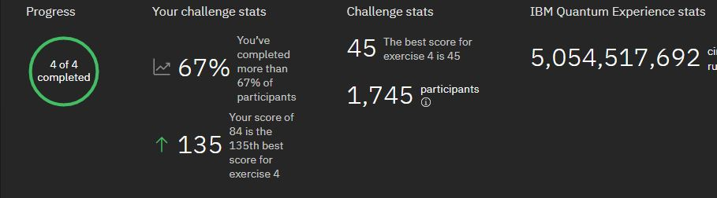
Acknowledgment
Supervisors: Dibakar Sigdel, Om Krishna Suwal, Shree Krishna Bhattarai
Association of Nepali Physicists in America (ANPA)
Khwopa College
Friends: Rodip Datheputhe, Supriya Dhakal, Anis gautam, Sagar Ganeju
Notes:
First I’d like to thank my supervisors:… for all the guidance, suggestions and help during the study.
I’d like to thank Association of Nepali Physicists in America (ANPA) for giving me a platform to learn grow and build a network with physicist around the world. With their support and collaboration, I participated in some challenges: IBM qiskit challenge 2020, Qiskit global summer school, Qiskit India hackathon.
I’d like to thank Khwopa College and incharge of Depart of physics and env science: Mira prajapati for all the support

Slide 18
References
Cheung, D. (2003). Using generalized quantum Fourier transforms in quantum phase estimation algorithms (Doctoral dissertation, University of Waterloo [Department of Combinatorics and Optimization]).
Hamdi, S. M., Zuhori, S. T., Mahmud, F., & Pal, B. (2014). A compare between Shor's quantum factoring algorithm and general number field sieve. 2014 International Conference on Electrical Engineering and Information & Communication Technology. doi:10.1109/iceeict.2014.6919115
Hidary, J. D. (2019). Quantum Computing: An Applied Approach (pp. 1-351). Cham: Springer
Loceff, M. (2016). A Course in Quantum Computing.
Martin-Lopez, E., Laing, A., Lawson, T., Alvarez, R., Zhou, X. Q., & O'brien, J. L. (2012). Experimental realization of Shor's quantum factoring algorithm using qubit recycling. Nature photonics, 6(11), 773-776.
Monz, T., Nigg, D., Martinez, E. A., Brandl, M. F., Schindler, P., Rines, R., ... & Blatt, R. (2016). Realization of a scalable Shor algorithm. Science, 351(6277), 1068-1070.
Nielsen, M. A., & Chuang, I. (2002). Quantum computation and quantum information.
Open-source quantum development. (n.d.). Retrieved February 20, 2021, from https://qiskit.org/
Zhang, L., Miranskyy, A., & Rjaibi, W. (2020). Quantum Advantage and Y2K Bug: Comparison. IEEE Software.

